Slide 1
Index.
Starting … 2
Visual interface … 3
Data loading … 4
Image visualization … 5
Structure/Mitochondria Correction … 9
Subset generation … 10
Parallel coordinate plot … 11
8) 2D projection plot … 12
9) Analysis type … 13
10) Snapshot … 14

Slide 2
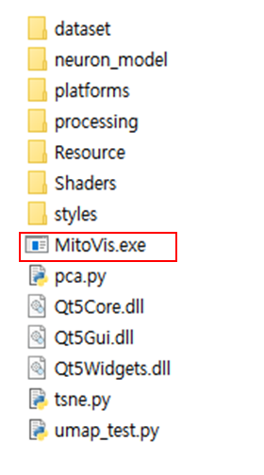
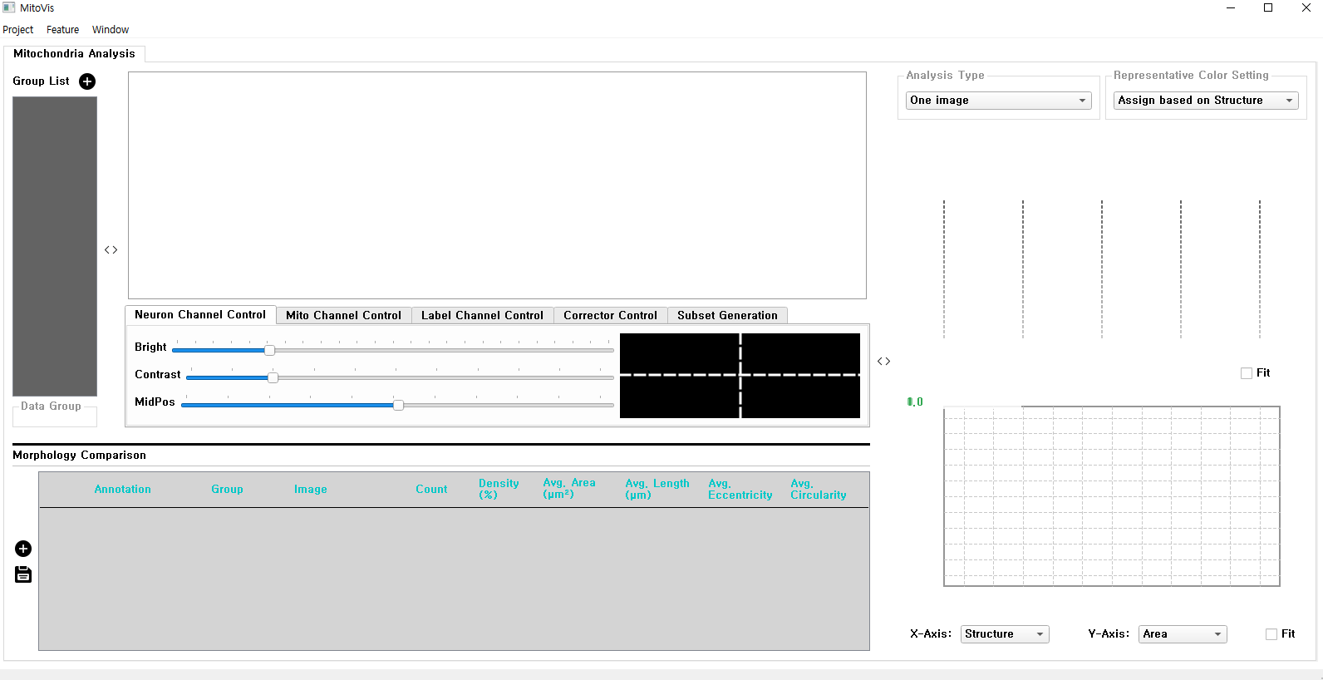
Starting
* If Microsoft Visual C++ 2017 is not installed,
run (Additional/vc_redist.x64.exe) to install it.
* Deep learning methods requires Python environment. For the detail, please refer to (Manuals/1. Environment setting.pptx)
Run!
Initial view

Slide 3
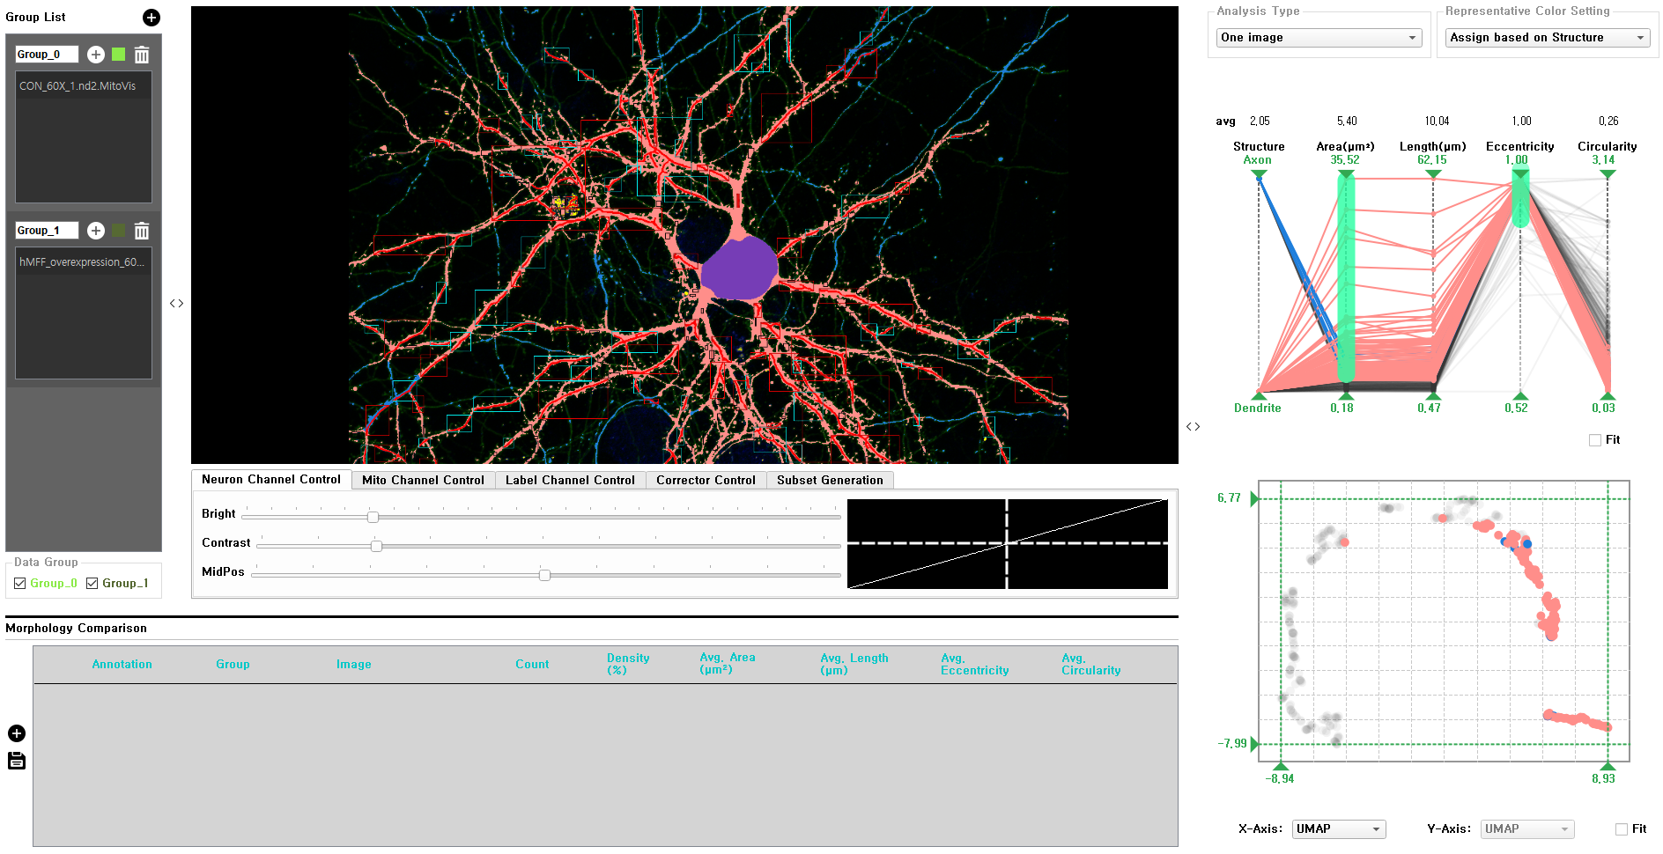
Visual interface
Data management panel
Image Viewer
Analysis panel
Control panel
Layout control
Morphology comparison panel

Slide 4
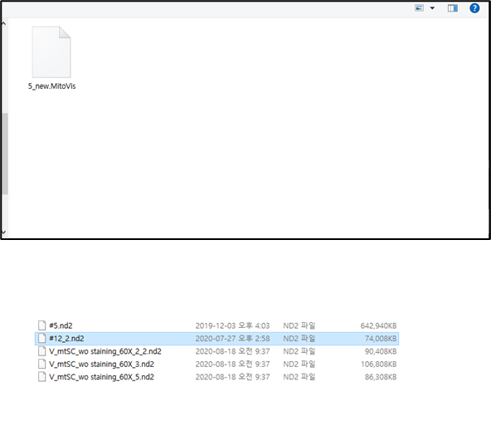
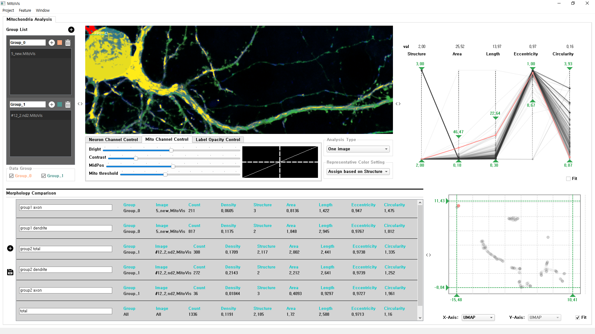
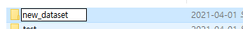
Data loading
1. Group generation
2. Load data
3. Previously generated dataset (*.MitoVis) or new image (*.nd2, *.tif) can be loaded
4. Generate and select a folder to store the dataset
Switch the current data
When using the multiple dataset analysis mode, a specific group can be activated or deactivated.

Slide 5
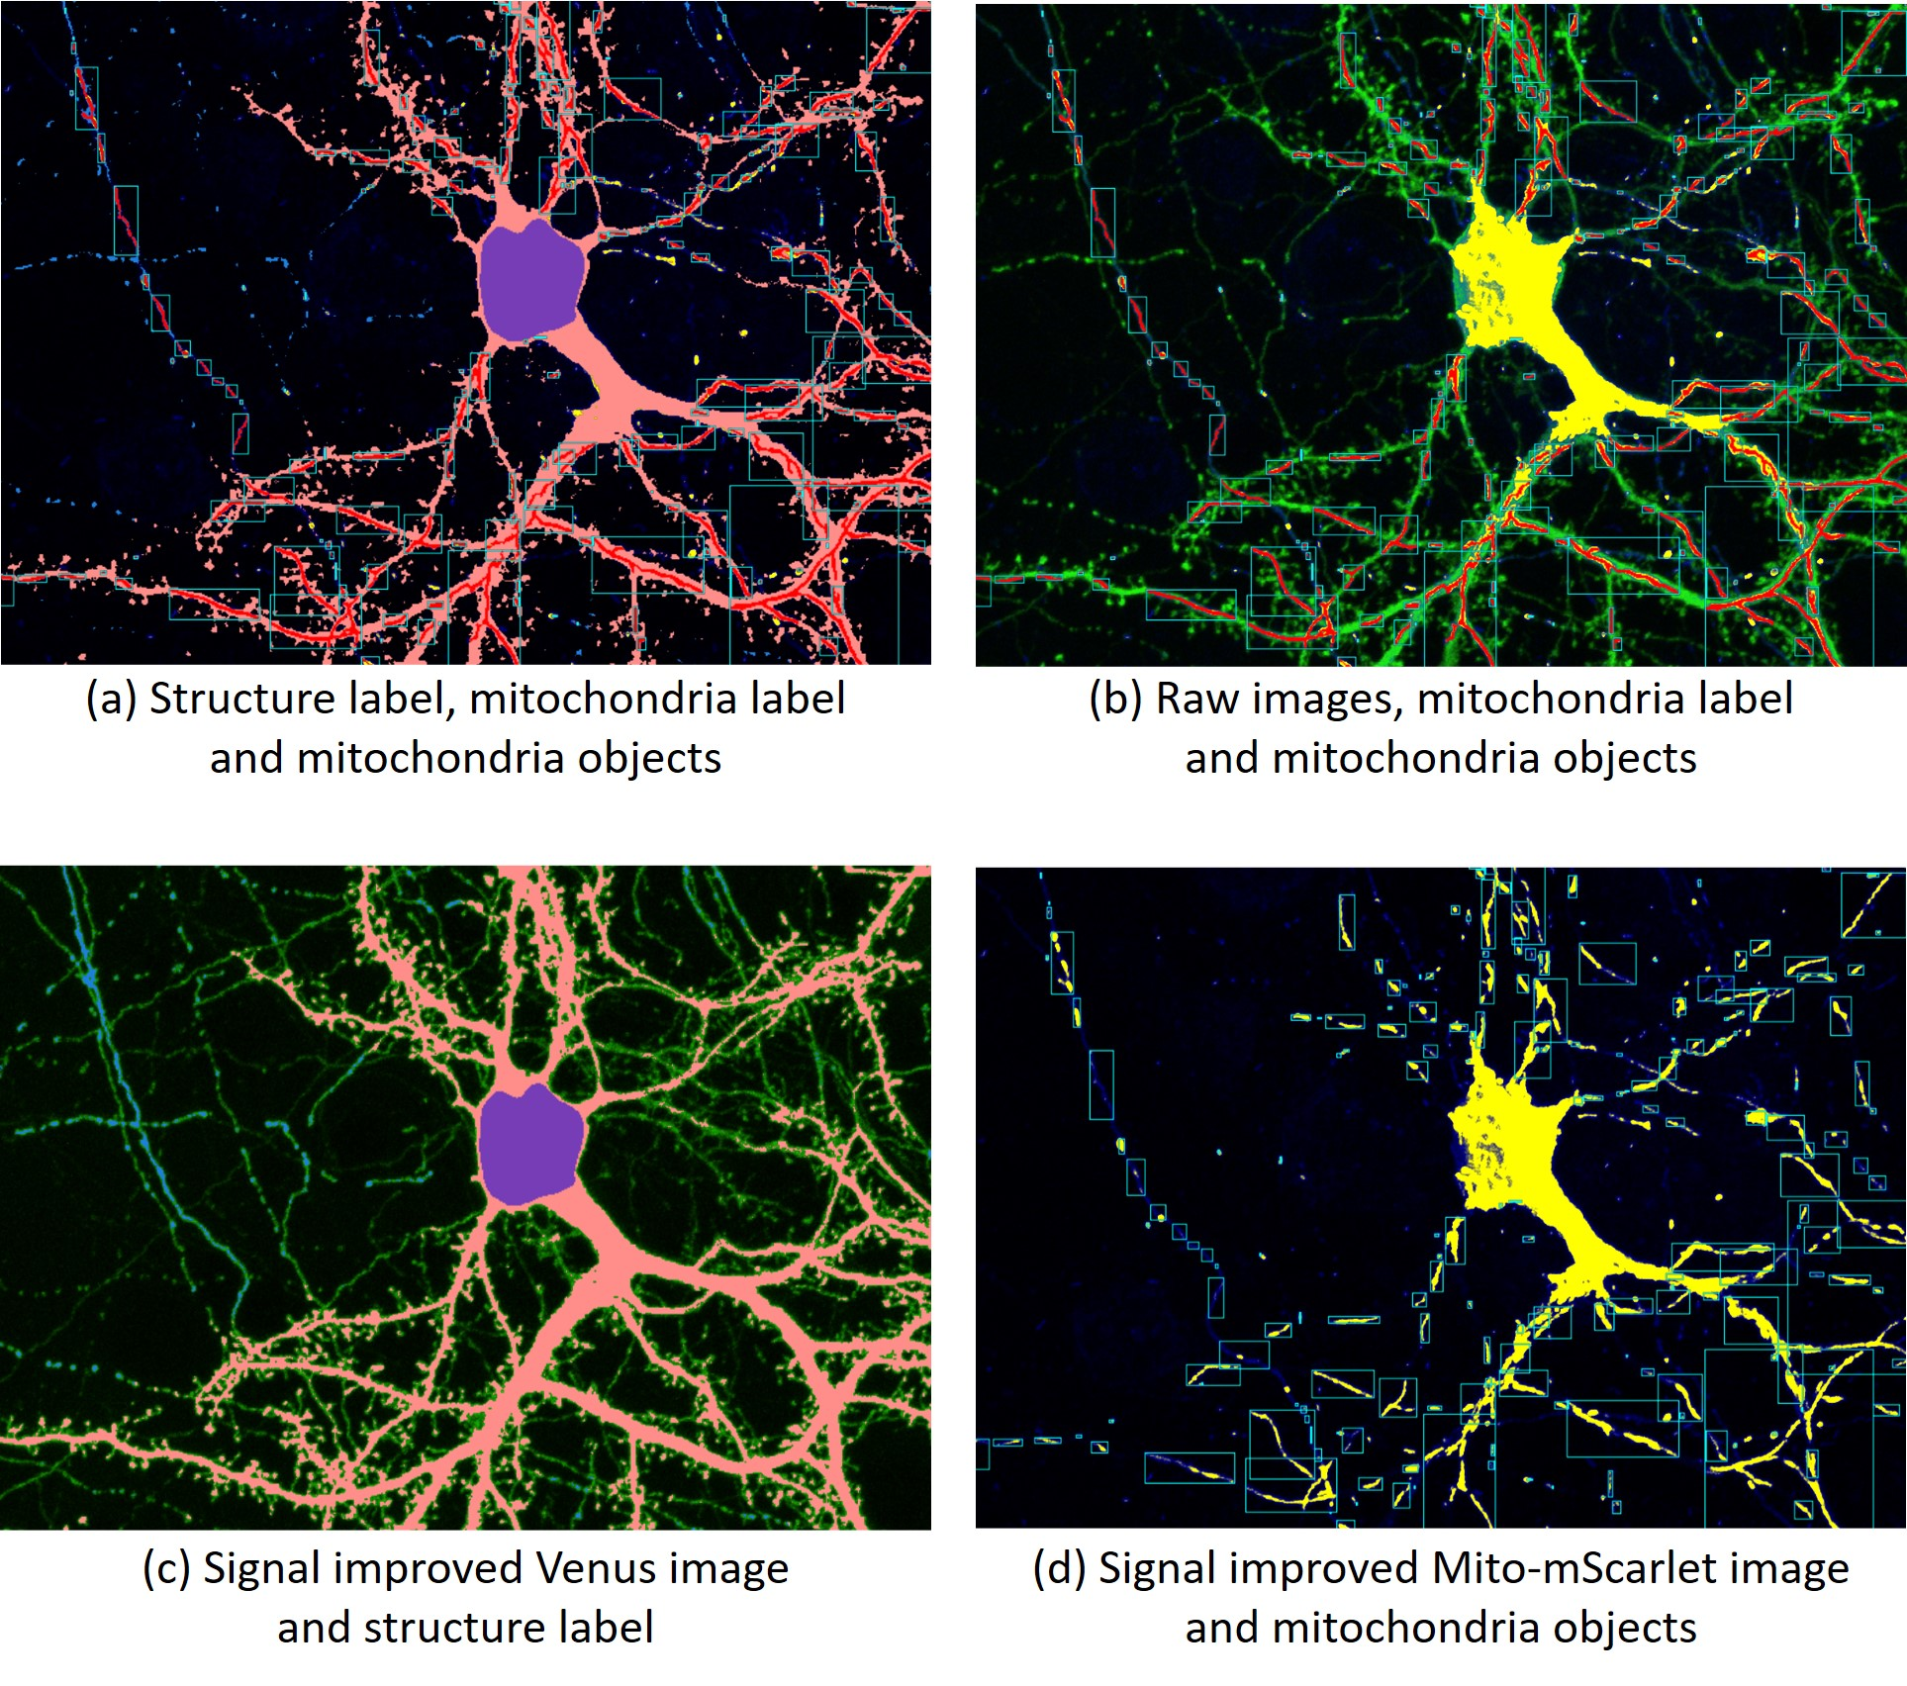
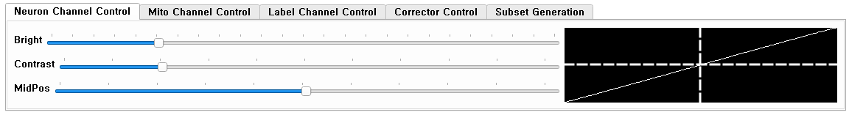
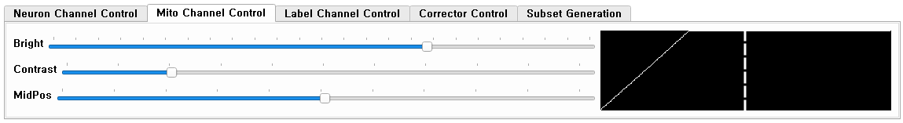
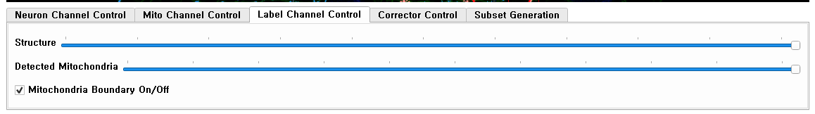
Image visualization
Various visualization generation by parameter adjustment

Slide 6
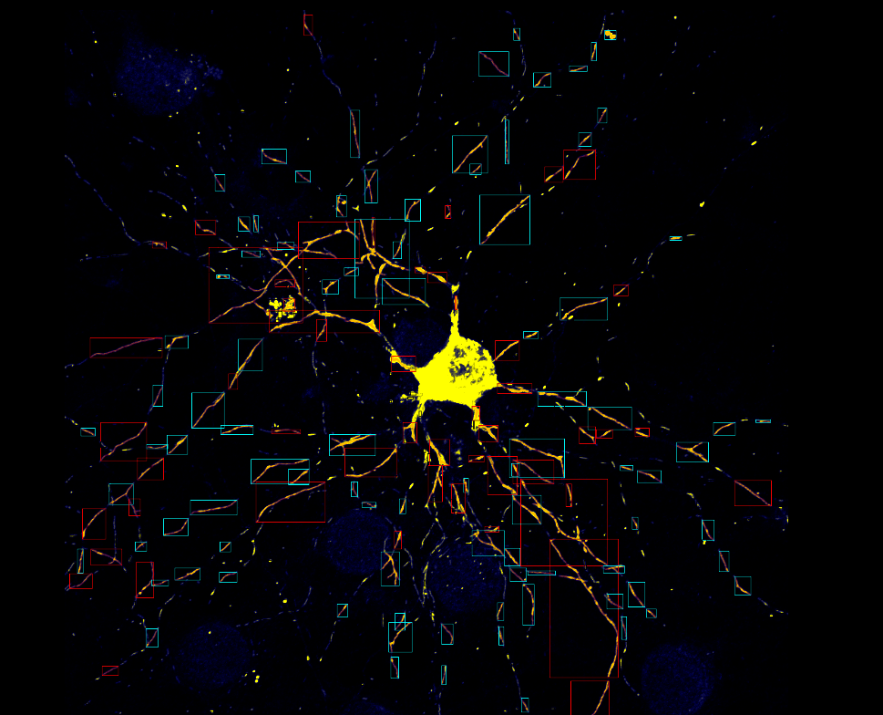
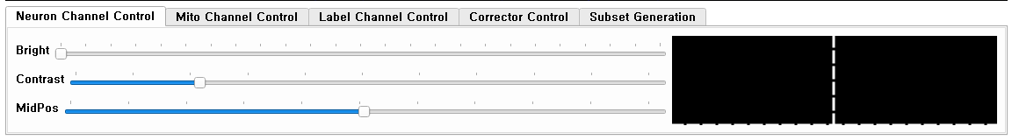
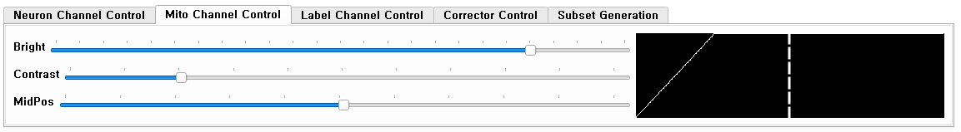
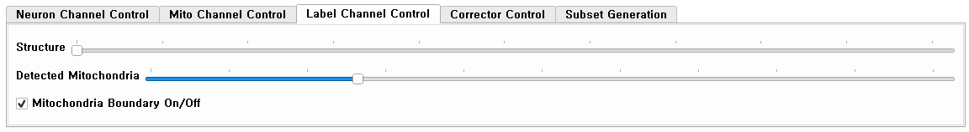
Image visualization
(Example)

Slide 7
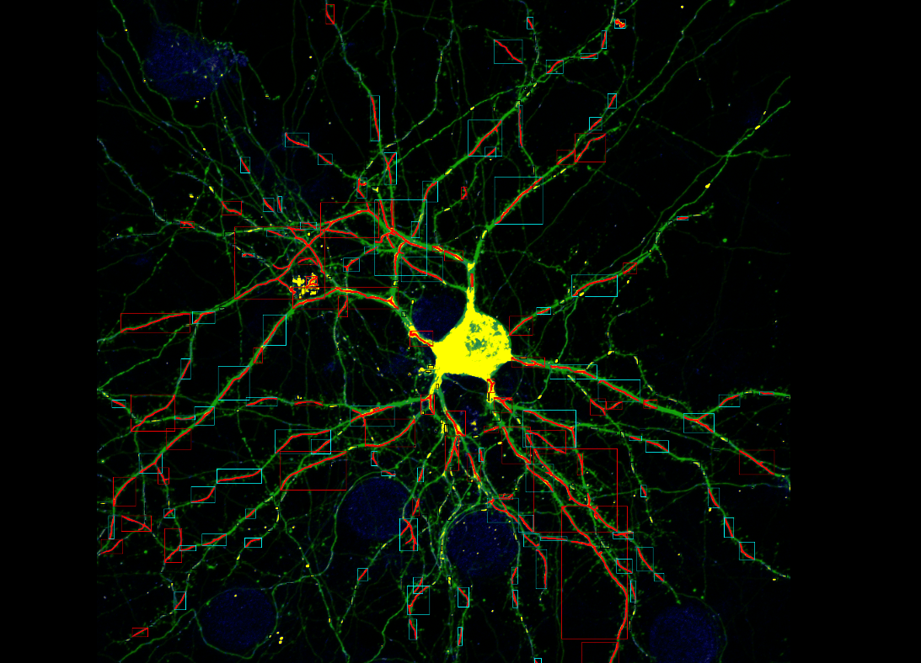
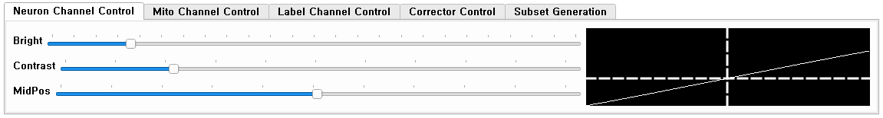
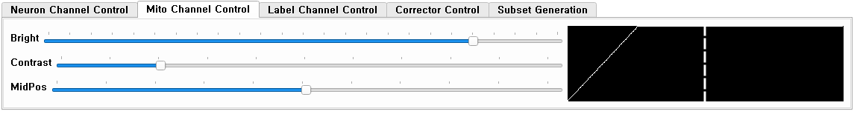
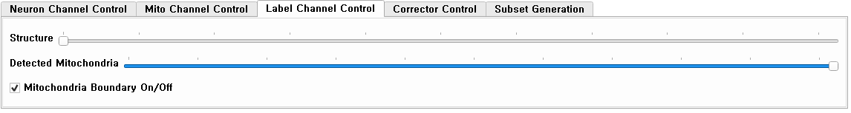
Image visualization
(Example)

Slide 8
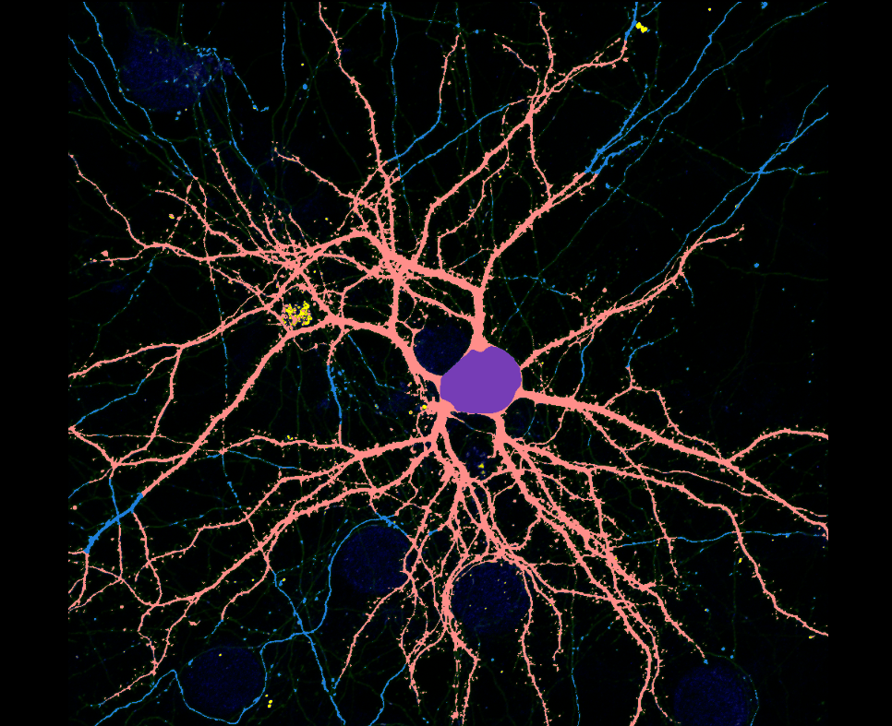
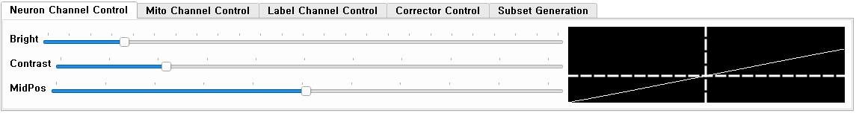
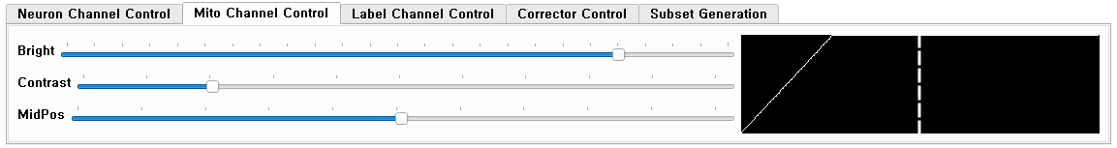
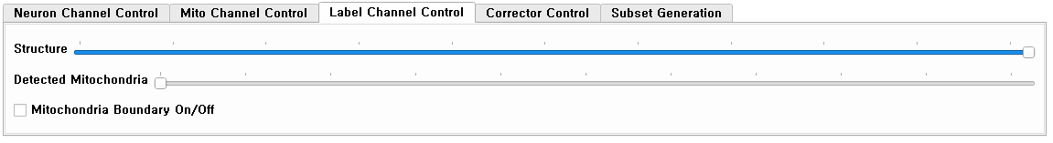
Image visualization
(Example)

Slide 9
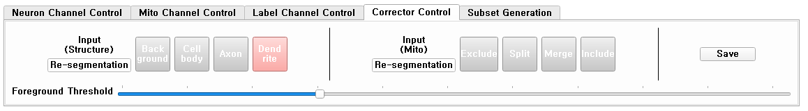
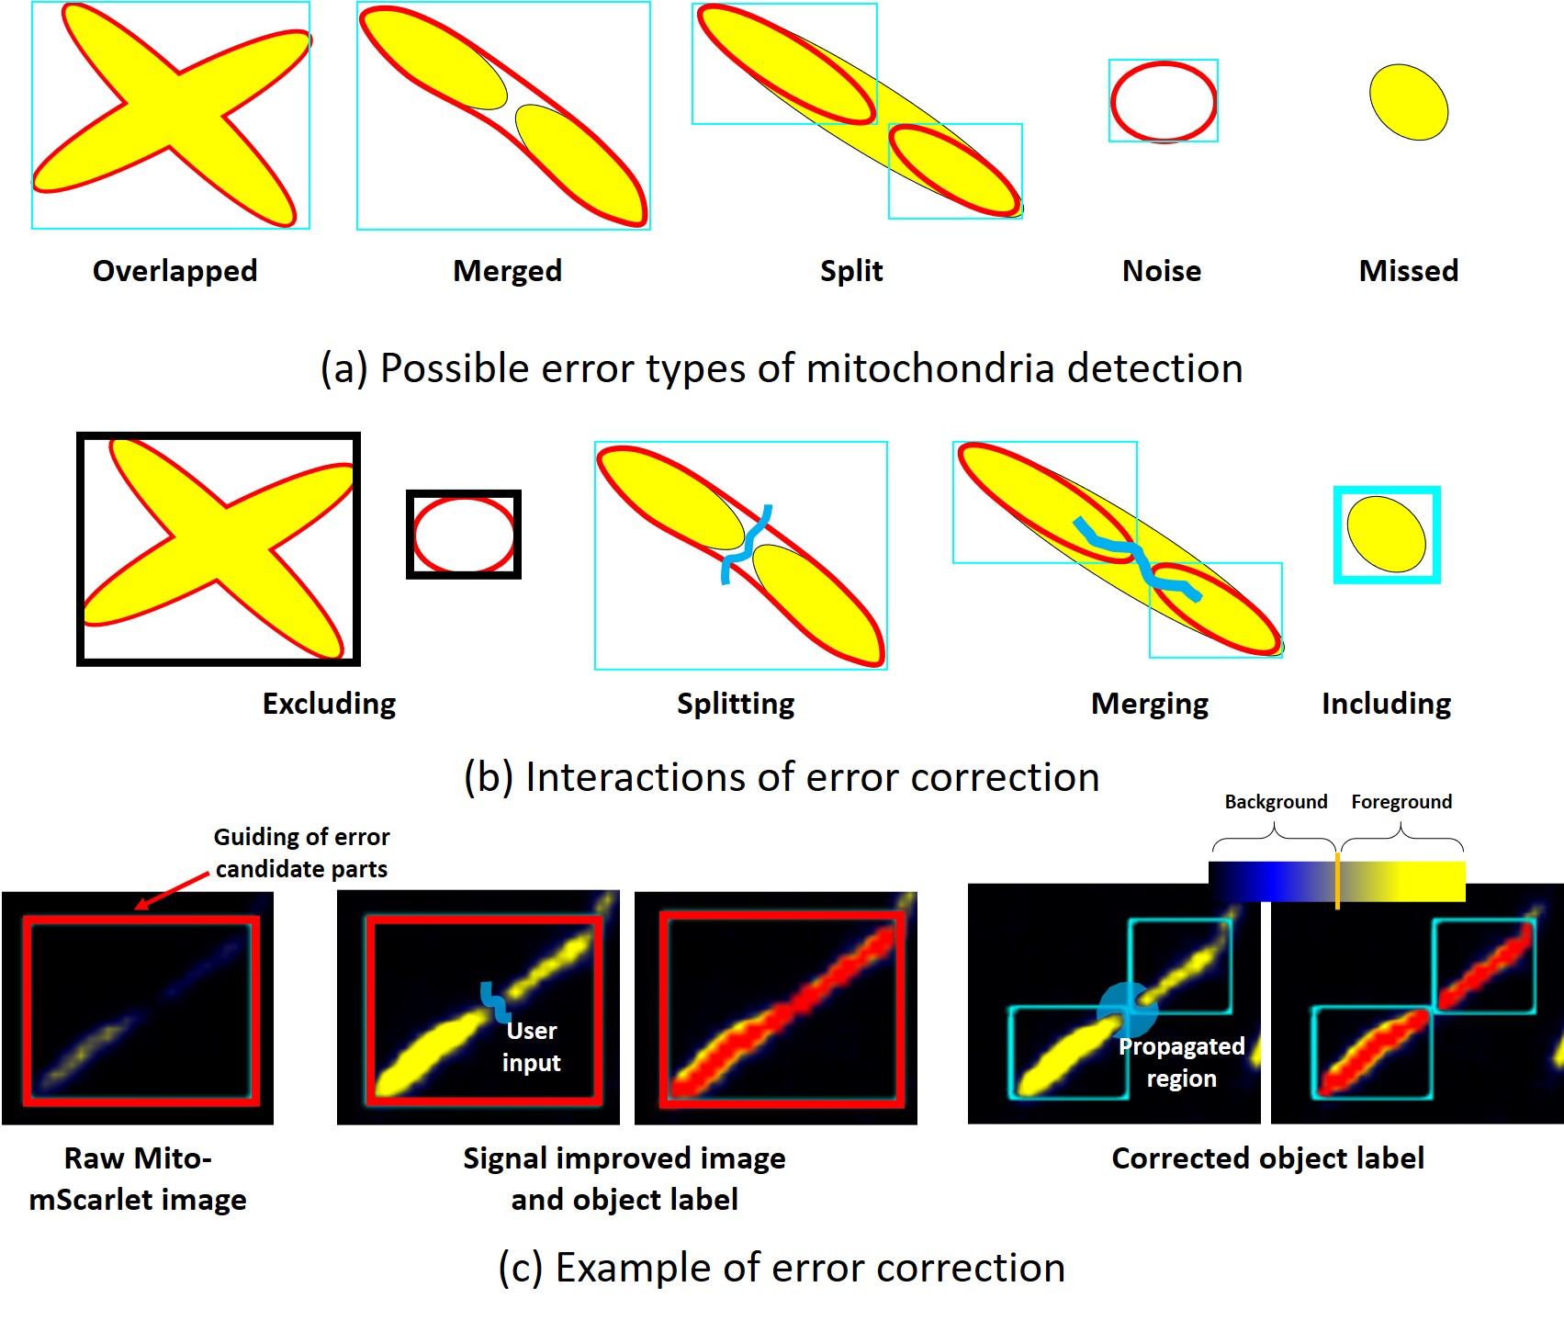
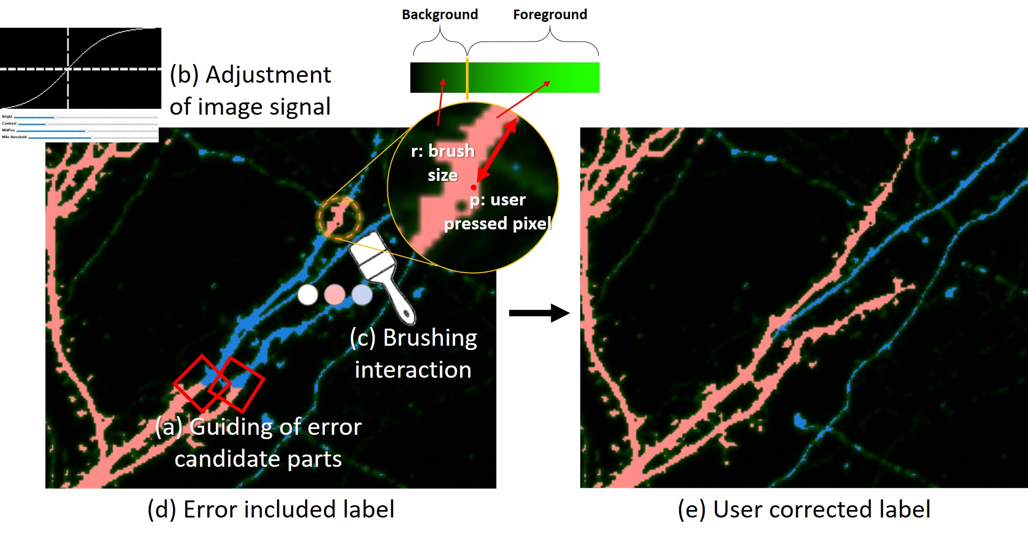
Structure/Mitochondria Correction
Structure correction and mitochondria correction available through corrector control panel (Refer to 3. Structure segmentation.pptx / 4. Mitochondria detection.pptx for details)

Slide 10
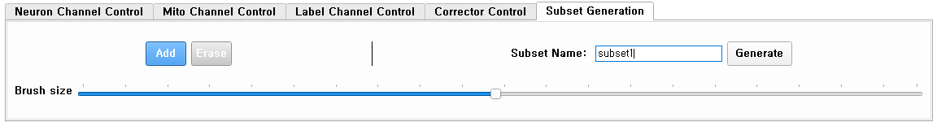
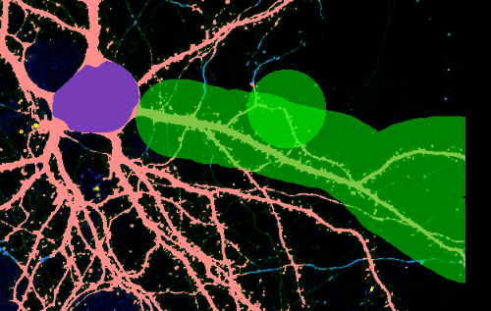
Subset generation
1. Add/erase brush for subregion filtering
4. Create a subset of the selected area in the folder with the input name (dataset/[input name]).
2. Adjust brush size with mouse wheel
3. Select an area by dragging the left button
Sub-dataset can be created for a specific region on the image through the Subset generation panel

Slide 11
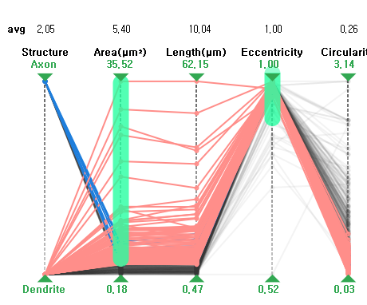
Parallel coordinate plot
Average feature value of currently selected data
Data filtering by dragging the right mouse button on each axis
Data filtering through thresholding
Adjust by dragging with the left mouse button
By hovering on each line, corresponding mitochondria can be checked in the image visualization panel.
Visualize the morphological feature values of each detected mitochondria in a parallel coordinate plot

Slide 12
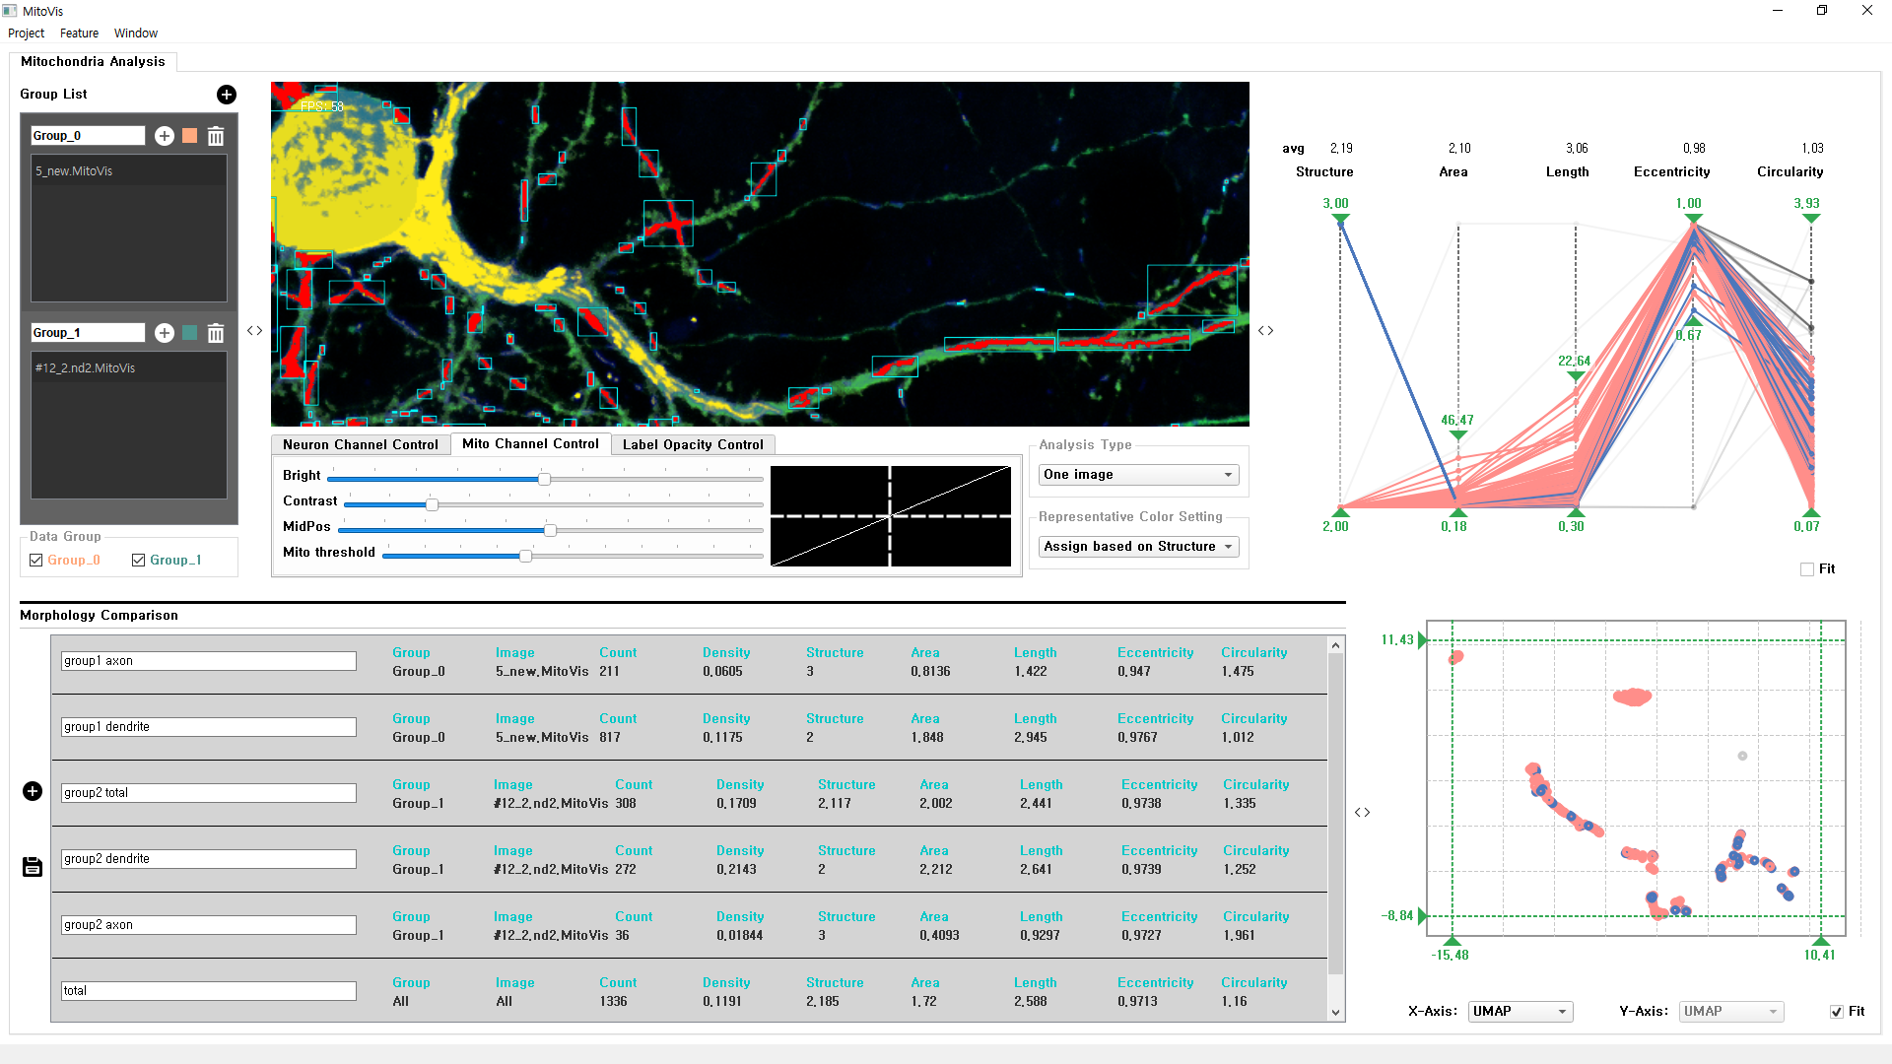
2D Projection plot
Data filtering through thresholding
Adjust by dragging the left mouse button
By hovering on each point, corresponding mitochondria can be checked in the image visualization panel.
Select the feature to be expressed on each axis
When PCA or UMAP is selected, the dimensionality reduction module is executed to create 2D points and then visualize them.
Select the feature to be expressed on each axis.
When PCA or UMAP is selected, the dimensionality reduction module is executed to create 2D points and then visualize them.

Slide 13
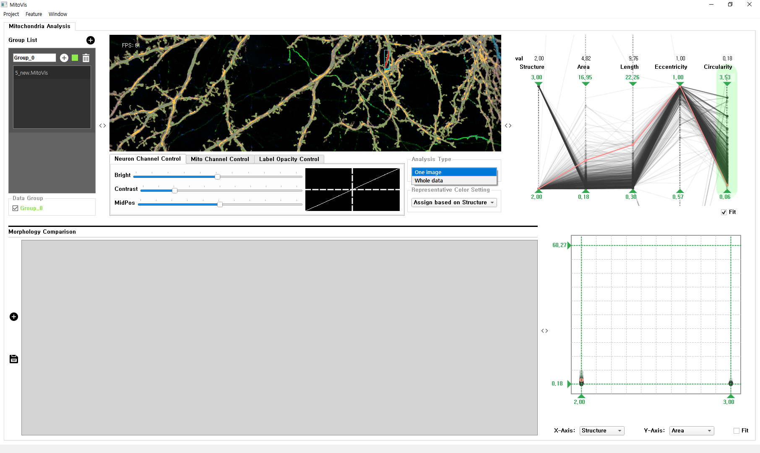

Analysis type
Analyze only one dataset
Only information of mitochondria in the current dataset is displayed in the parallel coordinate plot and 2D projection plot.
Analyze the entire dataset
Information of mitochondria of all datasets is displayed in parallel coordinate plot and 2D projection plot
Each line and point color can be specified on a group based

Slide 14
Snapshot
Add Snapshot for current subset
Add a comment for the current snapshot
If the analysis type is whole data, it is displayed as All.
If the analysis type is whole data, it is displayed as All.
Save snapshots as csv files
Mitochondrial density
(Mitochondrial area / Selected structure area)
Feature average value for selected data
Save the feature values for the current subset

